Slide 1
IBM Internet of Things

Slide 2
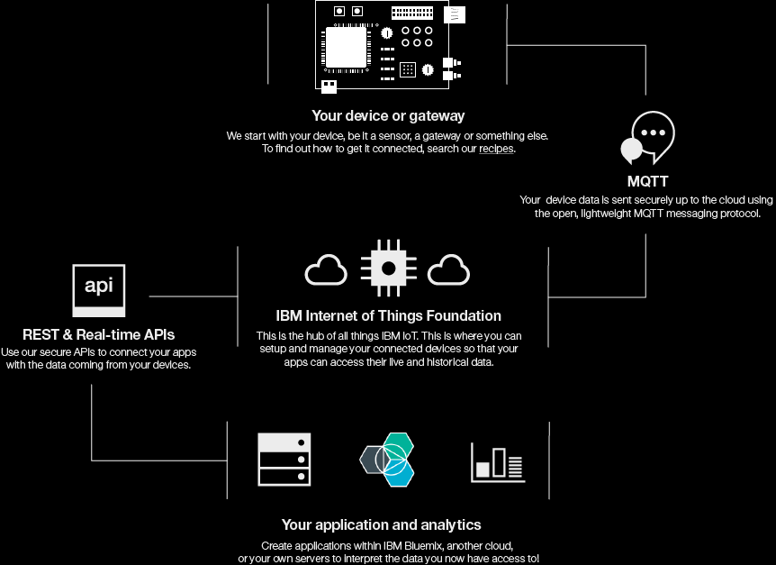

IBM IoT Zone schematic
IBM Internet of Things
Foundation

Slide 3
Bluemix IoT Recipes
Recipes are MQTT client agent residing on the gateway
https://developer.ibm.com/recipes/
List of supported recipes
Raspberry Pi
National Instruments LabVIEW
CC2650SimpleLink Bluetooth Smart BLE SensorTag
Intel Galileo
…more (refer link above)

Slide 4
Moving Data to Bluemix
Refer File “IoT_Bluemix_nodered.doc” for hands on
Use IoT Device simulator
http://quickstart.internetofthings.ibmcloud.com/iotsensor.

Slide 5
Connecting Gateway to Bluemix IoT Foundation
Refer File “IoTF_Raspberrypi.doc” for hands on
Quick start verification of Device data
https://quickstart.internetofthings.ibmcloud.com/#/device/
Reference for sending command back to gateway
http://diyhacking.com/raspberry-pi-home-automation-ibm-bluemix/
Further reference for connecting Rasperry Pi device with network and agent
https://www.ibm.com/developerworks/community/blogs/96960515-2ea1-4391-8170-b0515d08e4da/entry/Bluemix_IOT_baby_steps_with_Raspberry_pi?lang=en
https://www.google.co.in/url?sa=t&rct=j&q=&esrc=s&source=web&cd=2&ved=0ahUKEwjG7pLMh-LJAhVQBI4KHQKaDg0QFgguMAE&url=https%3A%2F%2Fwww.ibm.com%2Fdeveloperworks%2Fcommunity%2Ffiles%2Fbasic%2Fanonymous%2Fapi%2Flibrary%2Ff67e37d6-806f-4cab-bca8-ad75dcae56c0%2Fdocument%2F6d90648a-236d-4805-a512-467ad117947a%2Fmedia%2Fiot_myfirst_baby_steps.pdf&usg=AFQjCNGTmjiEltXbHC2rM7pyUsm5Q5Zzbw&sig2=R-EM1CbRkled3_qFCVAUoQ&cad=rja

Slide 6
IoT Airpollution Monitoring and other reference links
https://docs.internetofthings.ibmcloud.com/libraries/python.html
https://github.com/RajeshJeyapaul/IBMioTAirPollution
https://www.ibm.com/developerworks/community/blogs/96960515-2ea1-4391-8170-b0515d08e4da/entry/IoT_and_its_simplicity_using_IBM_Bluemix?lang=en
https://github.com/ibm-messaging/iot-python/
https://docs.internetofthings.ibmcloud.com/libraries/python.html
https://www.youtube.com/watch?v=YihgwVT6UKo

Slide 7
Backup slides

Slide 8
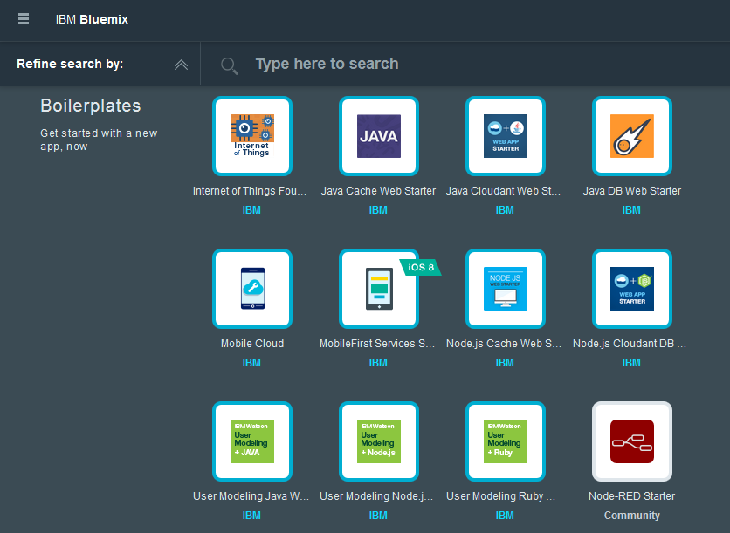
A key part of IBM’s Bluemix
IBM Bluemix – composable services development and ops
Run Your Apps
The developer can chose any language runtime or bring their own.
DevOps
Development, monitoring, deployment and logging tools allow the developer to run the entire application.
APIs and Services
Broad catalog of IBM, 3rd party, and open source, APIs and services to compose an application in minutes.
Cloud Integration
Build hybrid environments. Connect to on-premises systems of record plus other public and private clouds. Expose your own APIs to your developers.
Built on IBM SoftLayer
No need to worry about provisioning or managing infrastructure.

Slide 9





















IoT becomes a Composable Business
IoT end-end solutions
Connected appliance solutions, Smarter home solutions…
REST APIs
IoT-related Bluemix services
App tips open community
Rules, Push, Geo location, Analytics, Asset management, Predictive Maintenance…
Realtime MQTT APIs
REST APIs
IoT Foundation
Secure Device Registration, Scalable Device Connectivity, Historian, Visual wiring
Device recipe open community
Devices & Gateways

Slide 10


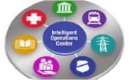



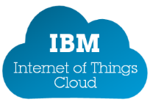

No company provides all the pieces Internet of Things solutions need an ecosystem
IBM Industry
Solutions, GBS
Streams
Maximo
PMQ
IoC
SDK
SDK
Partnerships
MessageSight
Devices
Gateways
Networks
Clouds
Solutions & Applications
Oil
& Gas
Energy
& Utilities
Smarter
Cities
Consumer
Electronics
Connected
Vehicle
Transport
& Rail
Life Science
& Healthcare
Industrial
Manufacturing

Slide 11
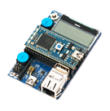
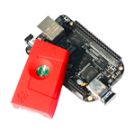
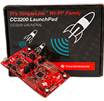
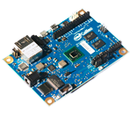
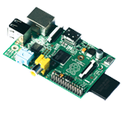
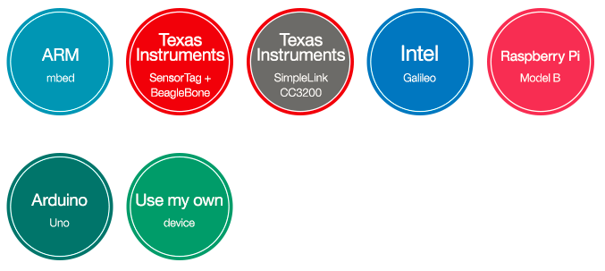
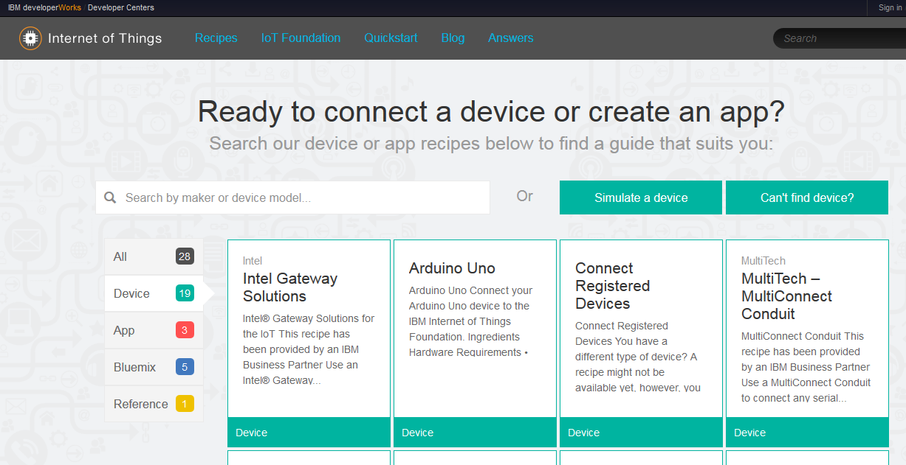
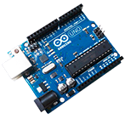

Device Recipes make it faster
Connect

Slide 12
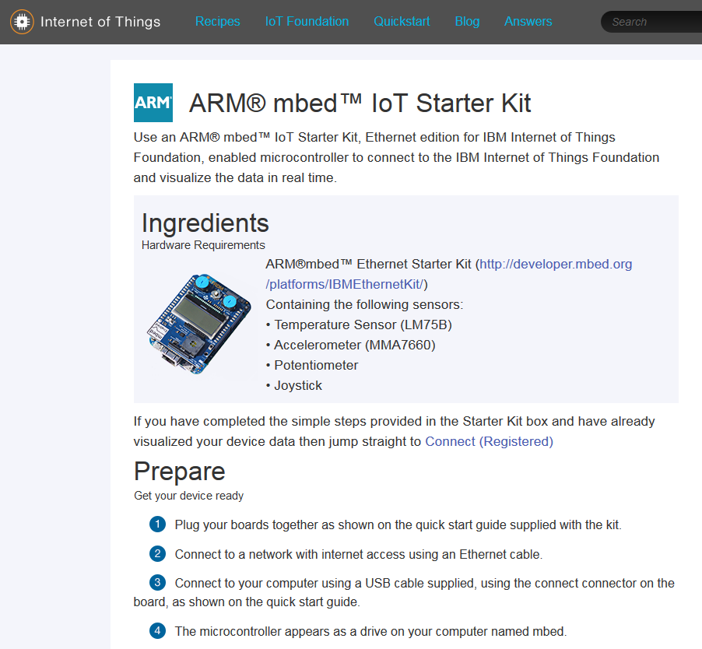
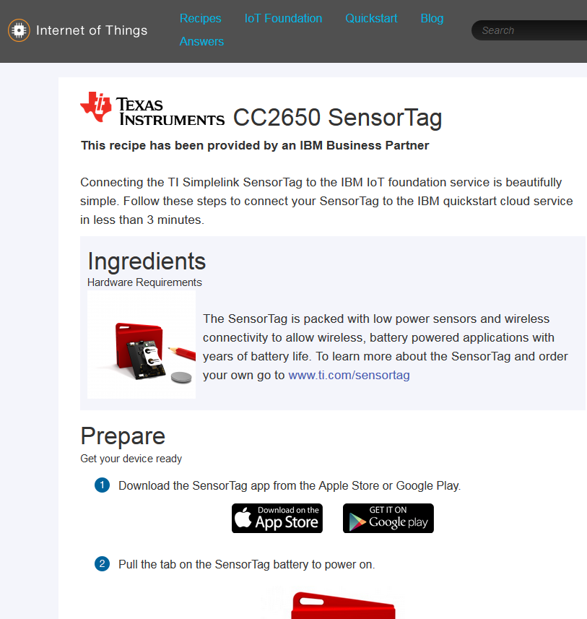
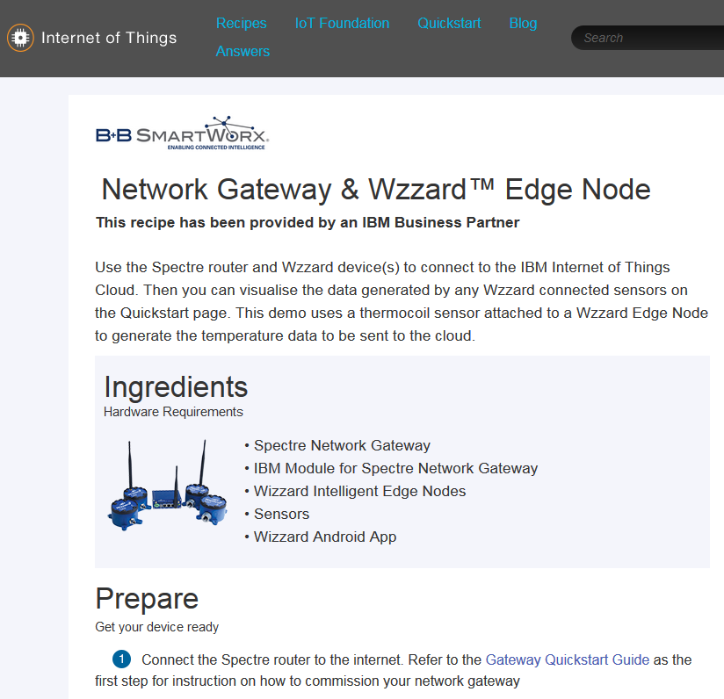
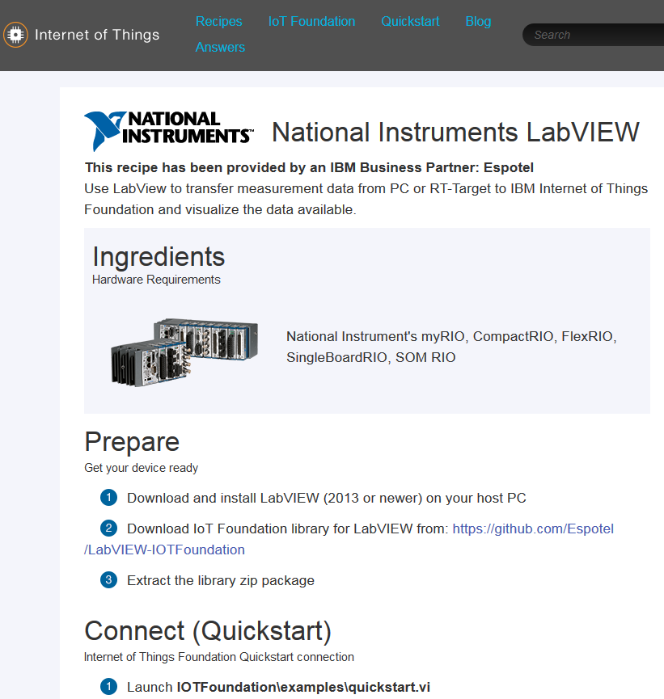
New device recipe examples
NEW

Slide 13
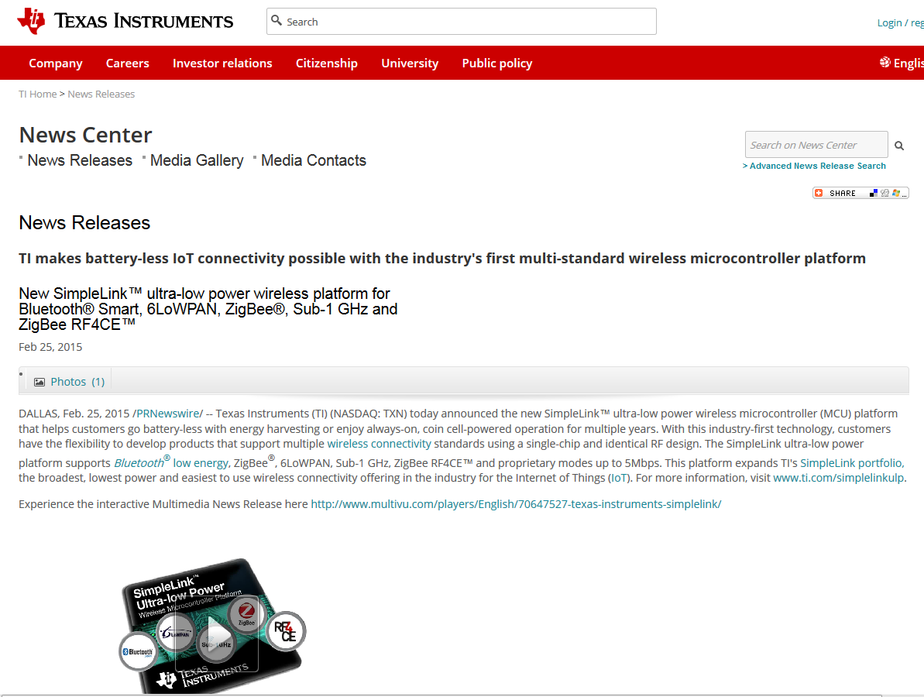
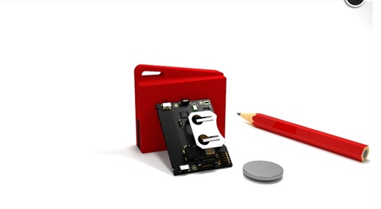
Texas Instruments released new SimpleLink MCUs and SensorTags
NEW
And what’s really exciting, is the SensorTags auto home to IBM IoT Foundation using the TI phone app as a gateway…
“OKAY - this is cool. So I actually ordered the new SensorTag from ti.com I downloaded the app, pulled the plastic tab and low and behold I was connected to the cloud. Simply AWESOME” (IBM User)

Slide 14

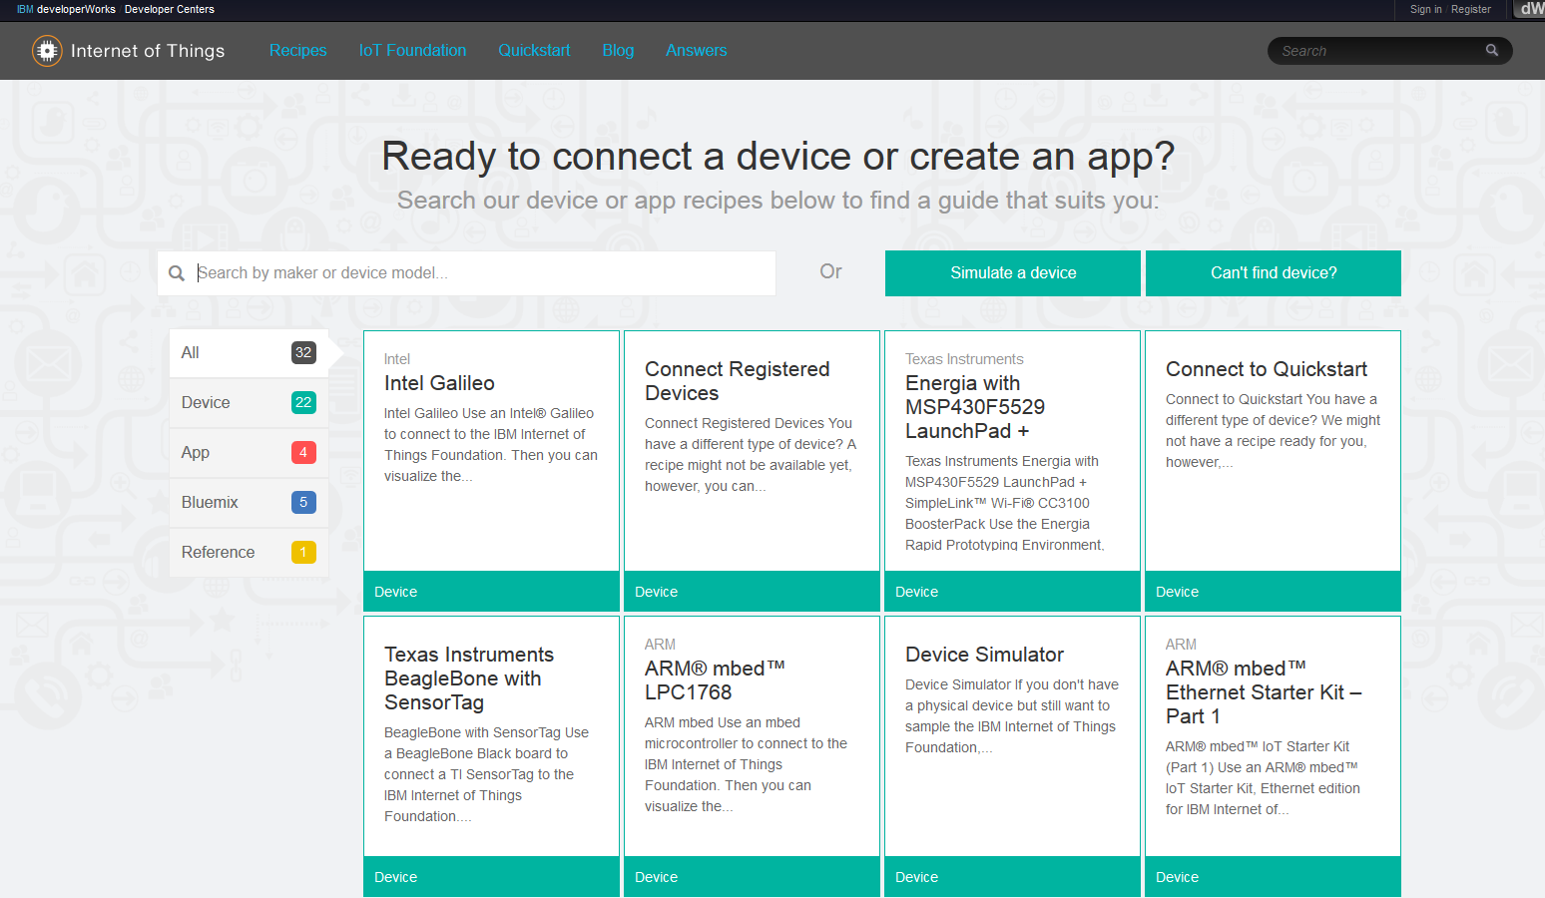
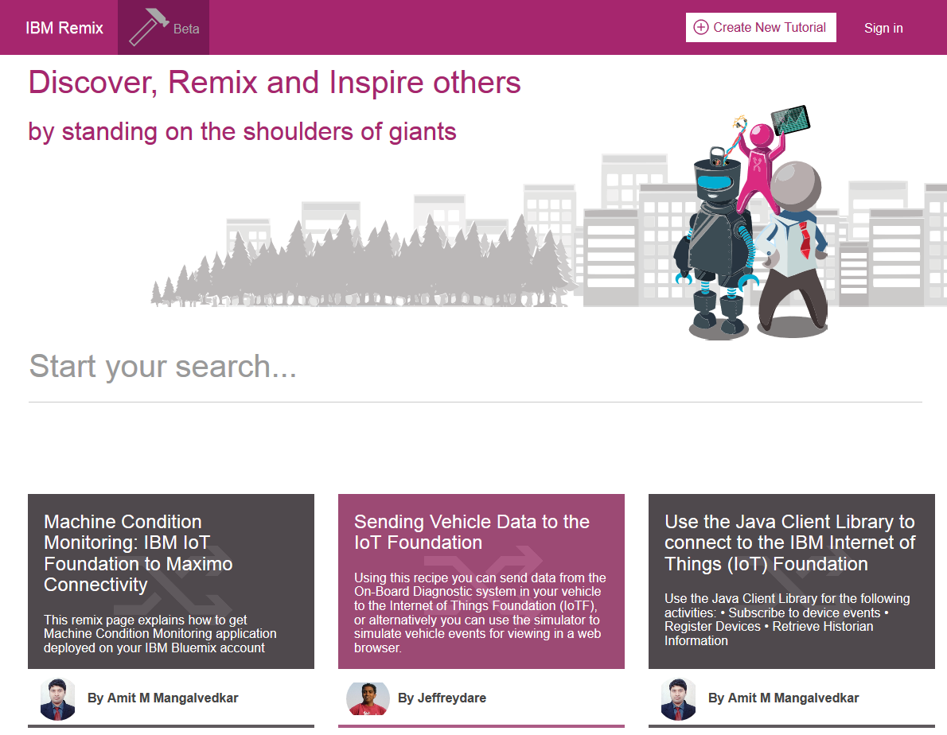
IBM Remix – from static to social
NEW
Interact with the community
Submit your own recipes

Slide 15
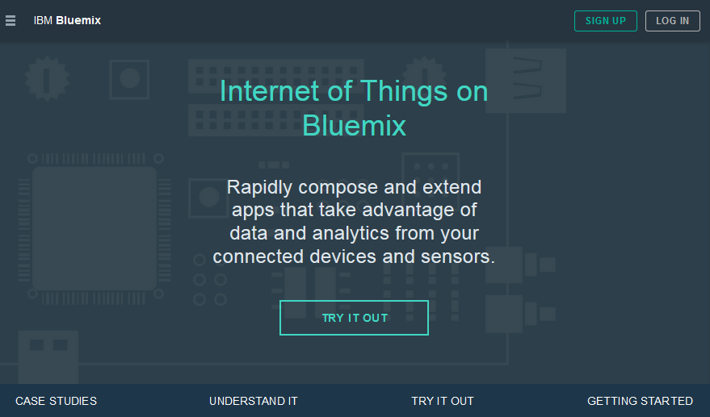
Our IoT Zone in Bluemix
NEW
https://bluemix.net/solutions/iot

Slide 16
IBM IoT Zone schematic
IBM Internet of Things
Foundation

Slide 17
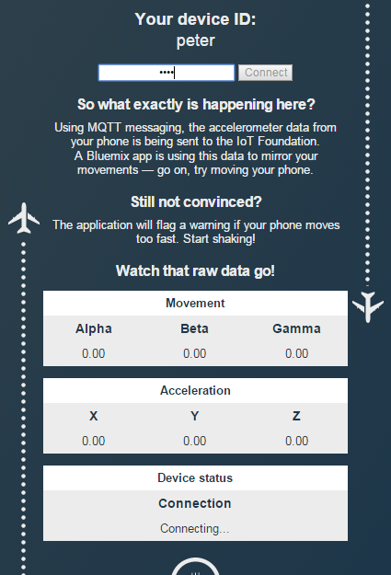
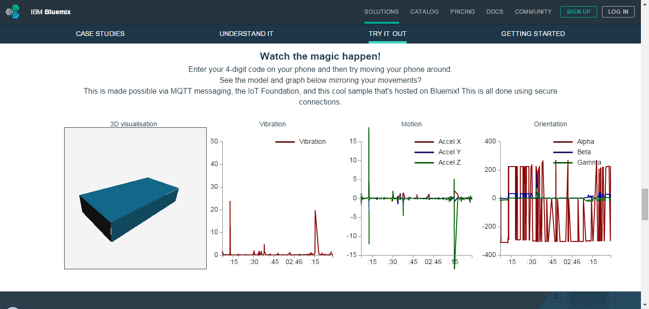
Try out the Bluemix IoT Zone Demo app

Slide 18
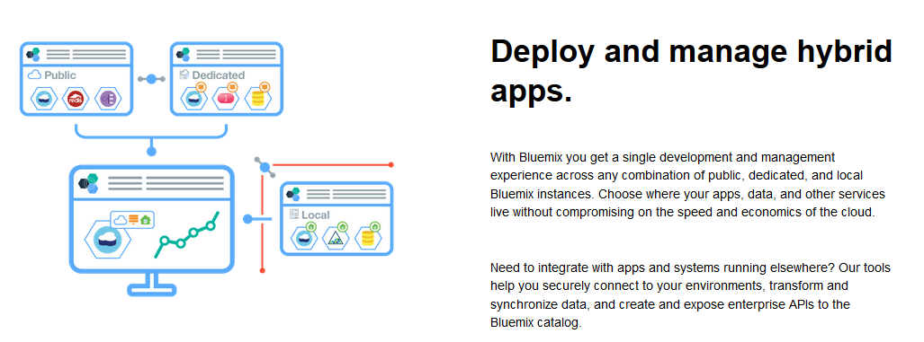
Syndication support for IoT
NEW
Access your IoT Foundation devices in public Bluemix from Dedicated Bluemix deployments

Slide 19
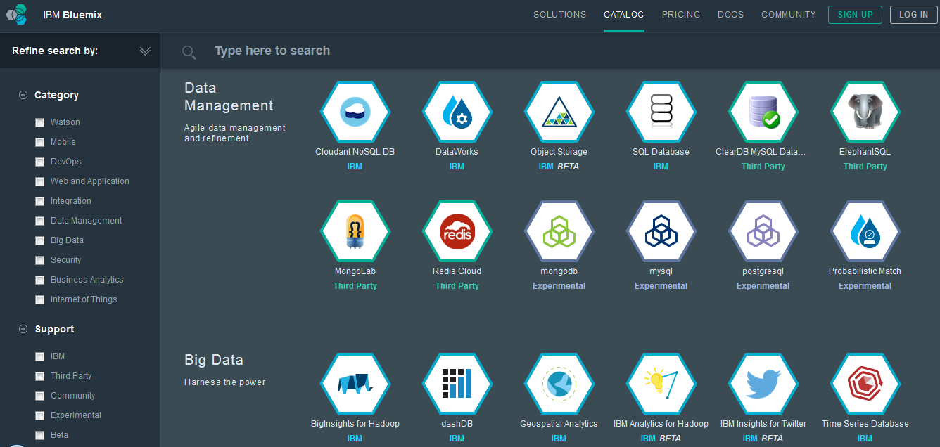
And when it’s time to glean insight … … Analytics available “as a Service” in Bluemix

Slide 20
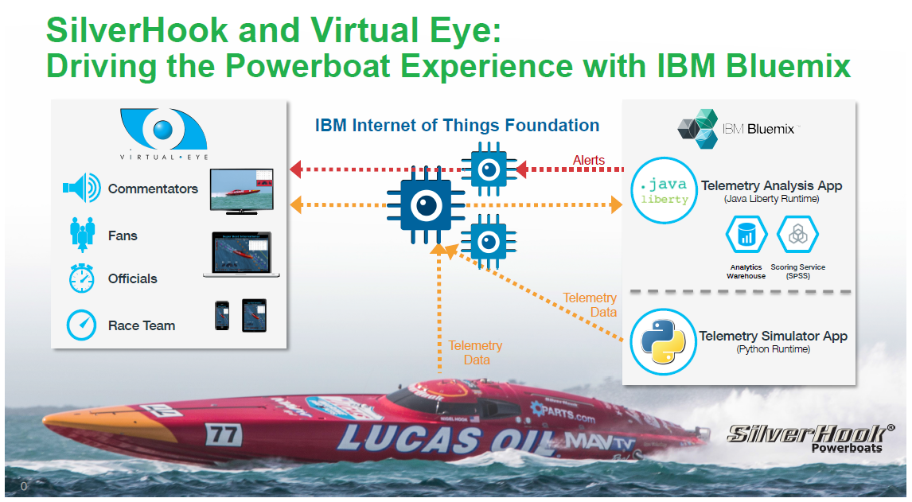
Our favourite use case !

Slide 21
Start your IoT project today!
Visit our IoT page
https://internetofthings.ibmcloud.com
Learn and build your first all on our new IoT Zone in Bluemix
https://bluemix.net/solutions/iot
Explore IoT Recipes
https://developer.ibm.com/iot/
Read IoT Blog articles
https://developer.ibm.com/iot/category/iot/
Interact with us on Twitter @IBMIoT

